Slide 1
SOEN 343
6b Unit testing

Slide 2
Learning objectives
To understand software testing
To apply test-driven development
To understand unit testing
To build unit tests using JUnit

Slide 3
Software testing
Software testing is meant to avoid software failure
A failure is caused by a fault in the code base
A symptom is an observable behavior of the system that enables us to observe a failure and possibly find its corresponding fault
The process of discovering what caused a failure is called fault identification
The process of ensuring that the failure does not happen again is called fault correction, or fault removal
Fault identification and fault correction is popularly called debugging
Software testing, in practice, is about identifying a certain possible system failure and design a test case that proves that this particular failure is not experienced by the software
“testing can reveal only the presence of faults, never their absence.” [Edsger Dijkstra]

Slide 4
Software testing
There are many levels and kinds of software testing:
Unit testing, integration testing, function testing, acceptance testing, installation testing
Unit testing can easily be integrated in the programming effort by using a Unit Testing Framework
However, unit testing cannot be applied for higher-level testing purposes such as function testing or acceptance testing, which are system-level testing activities

Slide 5
Test-driven development

Slide 6
Test-driven development (TDD)
TDD is a design technique that emphasizes unit testing with tests written before code
Developed by Kent Beck 1990’s
It consists of 3 steps:
Develop the test for the functionality they want to add
Develop the functional code until the test passes
Refactor both new/existing code to make it well structured

Slide 7
Misconceptions of TDD
100% regression tests are always possible
No, due to time restrictions or feasibility
Unit tests form 100% of design specification
It does not cover all design exercises needed
Only unit tests are necessary
Does not account for non-functionality attributes
TDD is sufficient for testing
No. What about usability, performance, etc.?
TDD can’t scale
No reason why it can’t scale

Slide 8
Unit testing

Slide 9
Unit testing
Definition: A unit test is a piece of code written by a developer that exercises a very small, specific area of functionality applied to one of the units of the code being tested. Usually, a unit test exercises some particular method in a particular context
Example: add a large value to a sorted list whose content is known, then confirm that this value appears at the end of the list
The goal of unit testing is to isolate important parts (i.e. units) of the program and show that the individual parts are free of certain faults

Slide 10
Benefits of unit testing
Facilitates change:
Unit testing allows the programmer to change or refactor code later, and make sure the module still works correctly after the change (i.e. regression testing)
Simplifies integration:
Unit testing helps to eliminate uncertainty in the units and can be used in a bottom-up integration testing style approach
Documentation:
Unit testing provides a sort of living documentation of the specifications of the units of the system
Developers looking to learn what functionality is provided by a unit and how to use it can look at the unit tests to gain understanding of the unit’s API specifications

Slide 11
Benefits of unit testing (contd.)
Distributes feedback:
Identifies defects early and regularly in the development cycle and avoids to cluster the finding of bugs in the later stages
Confidence building:
Successful (and meaningful) tests builds up confidence in the code to everyone involved, which then may lead to write more tests and thus even more completeness in testing
Forces analysis:
Writing unit tests forces the programmers to read and analyze their code, thus removing defects through constant code verification

Slide 12
Unit testing framework
For a large system, there can be thousands of unit tests, which can be tedious to maintain and execute
Automated testing supports maintainability and extensibility along with efficiency
A Unit Testing Framework lets a programmer associate classes and methods to corresponding test classes and test methods
Automation is achieved by automatically setting up a testing context, calling each test case, verifying their corresponding expected result, and reporting the status of all tests
Can be combined with the use of a control version system. Prior to any commit being made, unit testing is re-applied to make sure that the committed code is still working properly
Build automation tools can be used to integrate the testing process in the building process and be connected to the revision control process. e.g. Make, Ant, Maven, Gradle

Slide 13
JUnit

Slide 14
Using JUnit
A JUnit test is a method contained in a class which is only used for testing. This is called a Test class. To define that a certain method is a test method, annotate it with the @Test annotation
This method executes the code under test. You use an assert method, provided by JUnit or another framework, to check an expected result versus the actual result. These method calls are typically called asserts or assert statements
You should provide meaningful messages in assert statements. That makes it easier for the user to identify and fix the problem. This is especially true if someone looks at the problem, who did not write the code under test or the test code

Slide 15
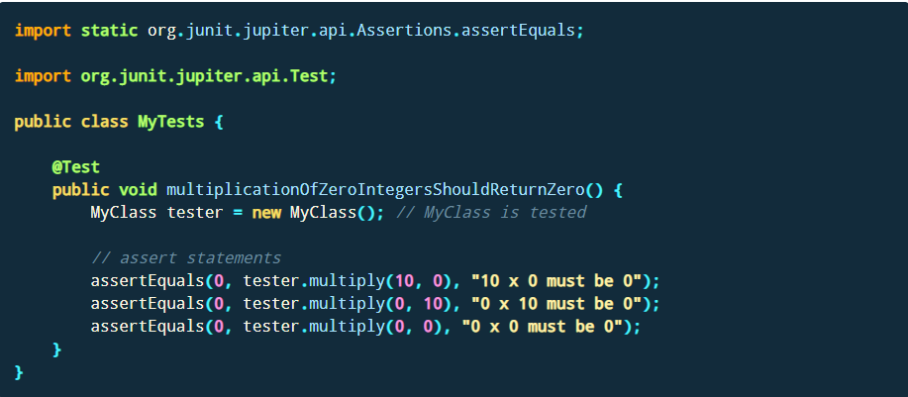
Example JUnit test
The following code shows a JUnit test using the JUnit 5 version. This test assumes that the MyClass class exists and has a multiply(int, int) method.

Slide 16

Test execution order
JUnit assumes that all test methods can be executed in an arbitrary order
Well-written test code should not assume any order, i.e., tests should not depend on other tests

Slide 17
Since JUnit 4 | Description
import org.junit.* | Import statement for using the following annotations.
@Test | Identifies a method as a test method.
@Before | Executed before each test. It is used to prepare the test environment (e.g., read input data, initialize the class).
@After | Executed after each test. It is used to cleanup the test environment (e.g., delete temporary data, restore defaults). It can also save memory by cleaning up expensive memory structures.
@BeforeClass | Executed once, before the start of all tests. It is used to perform time intensive activities, for example, to connect to a database. Methods marked with this annotation need to be defined as static to work with JUnit.
@AfterClass | Executed once, after all tests have been finished. It is used to perform clean-up activities, for example, to disconnect from a database. Methods annotated with this annotation need to be defined as static to work with JUnit.
@Ignore or @Ignore("Why disabled") | Marks that the test should be disabled. This is useful when the underlying code has been changed and the test case has not yet been adapted. Or if the execution time of this test is too long to be included. It is best practice to provide the optional description, why the test is disabled.
@Test (expected = Exception.class) | Fails if the method does not throw the named exception.
@Test(timeout=100) | Fails if the method takes longer than 100 milliseconds.

Slide 18
Assert statements
JUnit provides static methods to test for certain conditions via the Assert class
These assert statements typically start with assert. They allow you to specify the error message, the expected and the actual result
An assertion method compares the actual value returned by a test to the expected value. It throws an AssertionException if the comparison fails

Slide 19
Methods to assert test results
Statement | Description
fail([message]) | Let the method fail. Might be used to check that a certain part of the code is not reached or to have a failing test before the test code is implemented. The message parameter is optional.
assertTrue([message,] boolean condition) | Checks that the boolean condition is true.
assertFalse([message,] boolean condition) | Checks that the boolean condition is false.
assertEquals([message,] expected, actual) | Tests that two values are the same. Note: for arrays the reference is checked not the content of the arrays.
assertEquals([message,] expected, actual, tolerance) | Test that float or double values match. The tolerance is the number of decimals which must be the same.
assertNull([message,] object) | Checks that the object is null.
assertNotNull([message,] object) | Checks that the object is not null.
assertSame([message,] expected, actual) | Checks that both variables refer to the same object.
assertNotSame([message,] expected, actual) | Checks that both variables refer to different objects

Slide 20
JUnit test suites
If you have several test classes, you can combine them into a test suite
Running a test suite executes all test classes in that suite in the specified order
A test suite can also contain other test suites
The following example code demonstrates the usage of a test suite. It contains two test classes (MyClassTest and MySecondClassTest). If you want to add another test class, you can add it to the @Suite.SuiteClasses statement

Slide 21
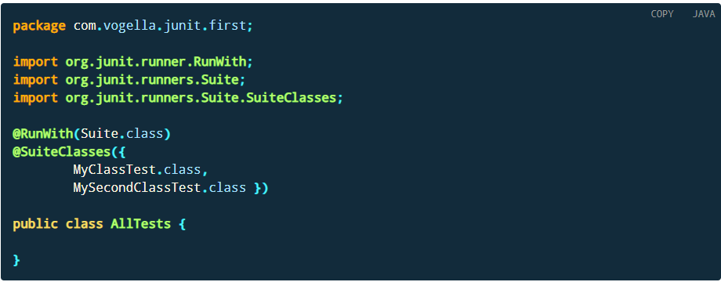
JUnit test suites

Slide 22
Parameterized test
JUnit allows you to use parameters in a tests class. This class can contain one test method and this method is executed with the different parameters provided
You mark a test class as a parameterized test with the @RunWith(Parameterized.class) annotation
Such a test class must contain a static method annotated with the @Parameters annotation
That method generates and returns a collection of arrays
Each item in this collection is used as parameter for the test method

Slide 23
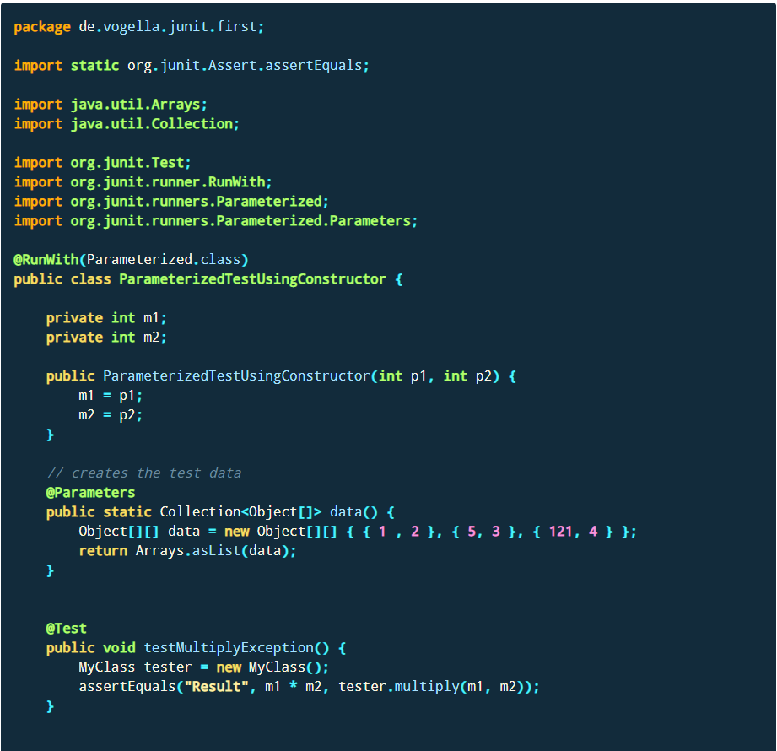

Slide 24
JUnit in the team project
You will be asked to write an increasing number of test cases for each build
Among these, some specific test cases will be asked for
Other test cases to your discretion, but all must be relevant and valid
All test cases should have the same structure:
Setting the context for the test
Call a method
Use JUnit assertions to verify that the method had correct result/effects

Slide 25
JUnit in the project (contd.)
All test cases must be clearly documented using JavaDoc
Description of what the test case is testing
Context (values set before the method is called, parameter values passed)
Expected result/effects
All JUnit classes should be in a separate folder whose structure should mirror the structure of your project
There should be a one-to-one relationship between your project classes and the JUnit classes

Slide 26
Summary
Software testing
TDD
Unit testing
JUnit
Test execution order
JUnit annotations
Assert statements
Methods to assert test results
JUnit test suites
Parametrized tests

Slide 27
References
Unit Testing with JUnit https://www.vogella.com/tutorials/JUnit/article.html
TutorialsPoint JUnit Quick Guide
JUnit.org. Frequently Asked Questions

